Slide 1
Vaccine ID Card Boomerang
Use Case
Workday has documented four solutions for tracking vaccine data in Workday:
Custom Object (Non-Effective Dated)
Custom Object (Effective Dated)
Request Framework with Questionnaire
Survey
Of these, only Custom Object (Effective Dated) and Request Framework allow for attachments, like a Vaccine ID Card.
The Custom Object (Effective Dated) can be setup to view the card through Worker Documents, but the Request Framework does not. We will use a boomerang to copy the ID card from the request into a Worker Document.
Community page for Solution Comparisons: https://community.workday.com/contributed/810824

Slide 2
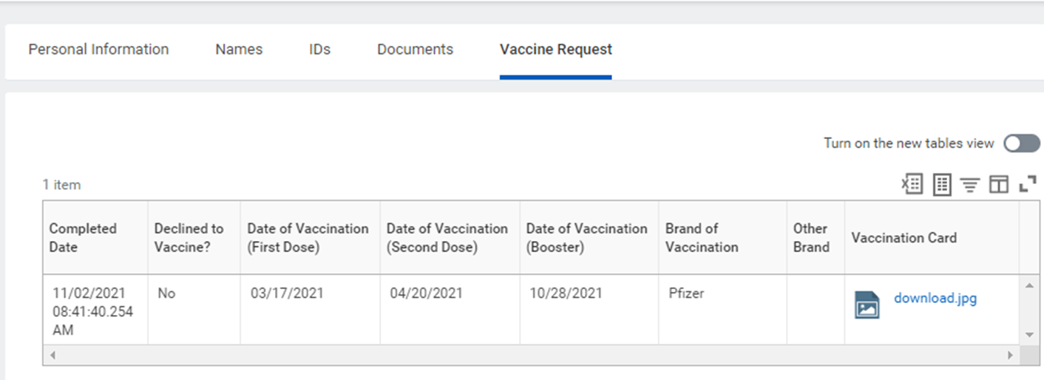
Completed Vaccine Request

Slide 3
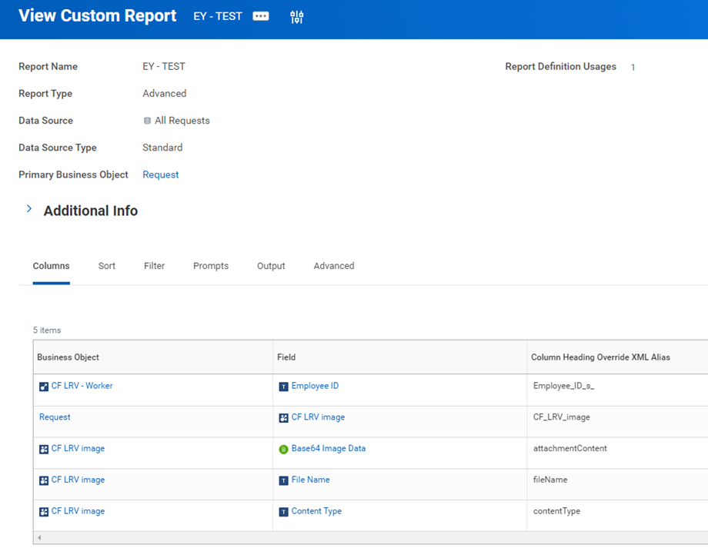
Custom Report - All Requests Data Source

Slide 4
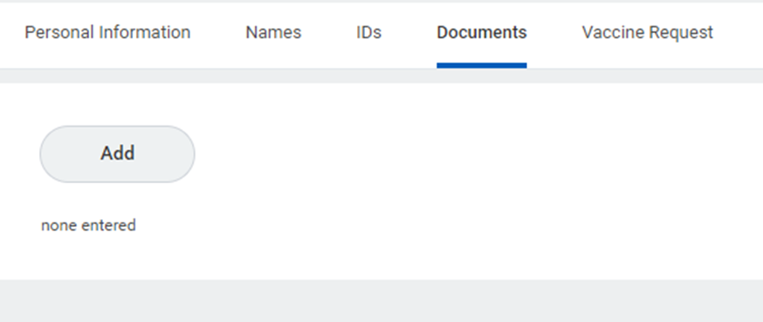
Empty Worker Documents

Slide 5
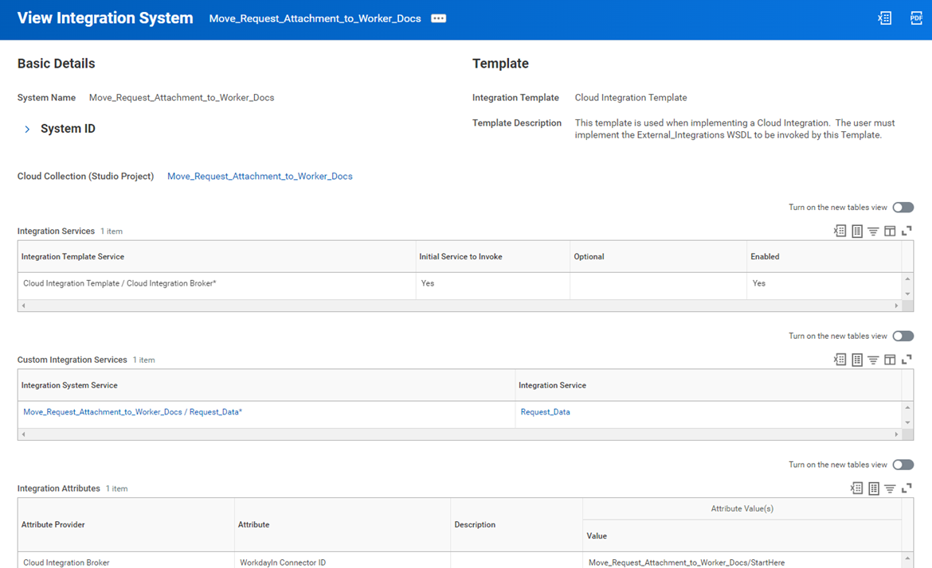
Workday Studio Boomerang Integration

Slide 6
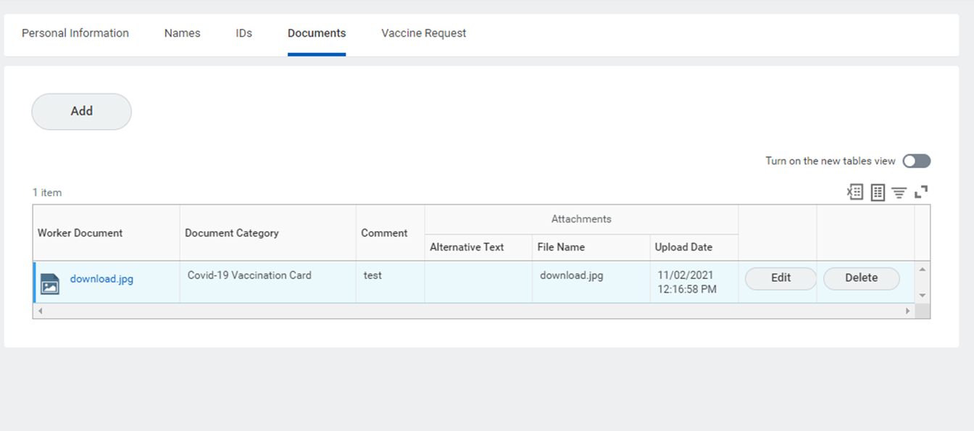
Vaccine Card Now Also in Worker Documents

